Slide 1
Introduction to TensorFlow

Slide 2

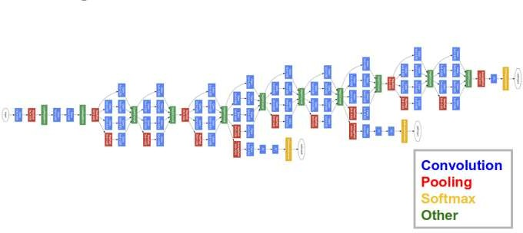
What is it?
An Open Source Machine Learning Library released by Google in 2015
Built on top of Google’s Inception v3
Google’s most advanced image recognition system
Convolution Neural Network (CNN)
Available as a Python (or C++) Library

Slide 3
Basics – What is a Vector?
A vector is an array of numbers.
Vector = [ number, number, … ]
In machine learning, a vector holds the feature values (variables) for a sample.
Vector =
24 | 16 | 5 | 120000
Age
Education Level
Years of Experience
Income

Slide 4
Basics – What is a Matrix?
A matrix is a 2-dimensional array of numbers.
Matrix = [ n ][ m ]
In machine learning, a matrix holds the feature values [columns] for samples [rows] in a dataset.
Matrix =
24 | 16 | 5 | 120000
27 | 12 | 8 | 70000
28 | 18 | 2 | 135000
Age
Education Level
Years of
Experience
Income

Slide 5
What is a Tensor?
A tensor is a high dimensional array.
Tensor = [ n1 ][ n2 ] … [ nx ]
A tensor consists of features, where each feature is a vector or multi-dimensional array (e.g., such as in embedding).
Features
1
4
7
A Sample
2
5
8
3
6
9

Slide 6
Design & Run
TensorFlow uses a Design & Run methodology.
Design
(symbolic representation)
Construct training model
symbolically.
Once designed, bind (connect) the data and execute the model.
Run
(bind the data and execute)
Data
Output

Slide 7
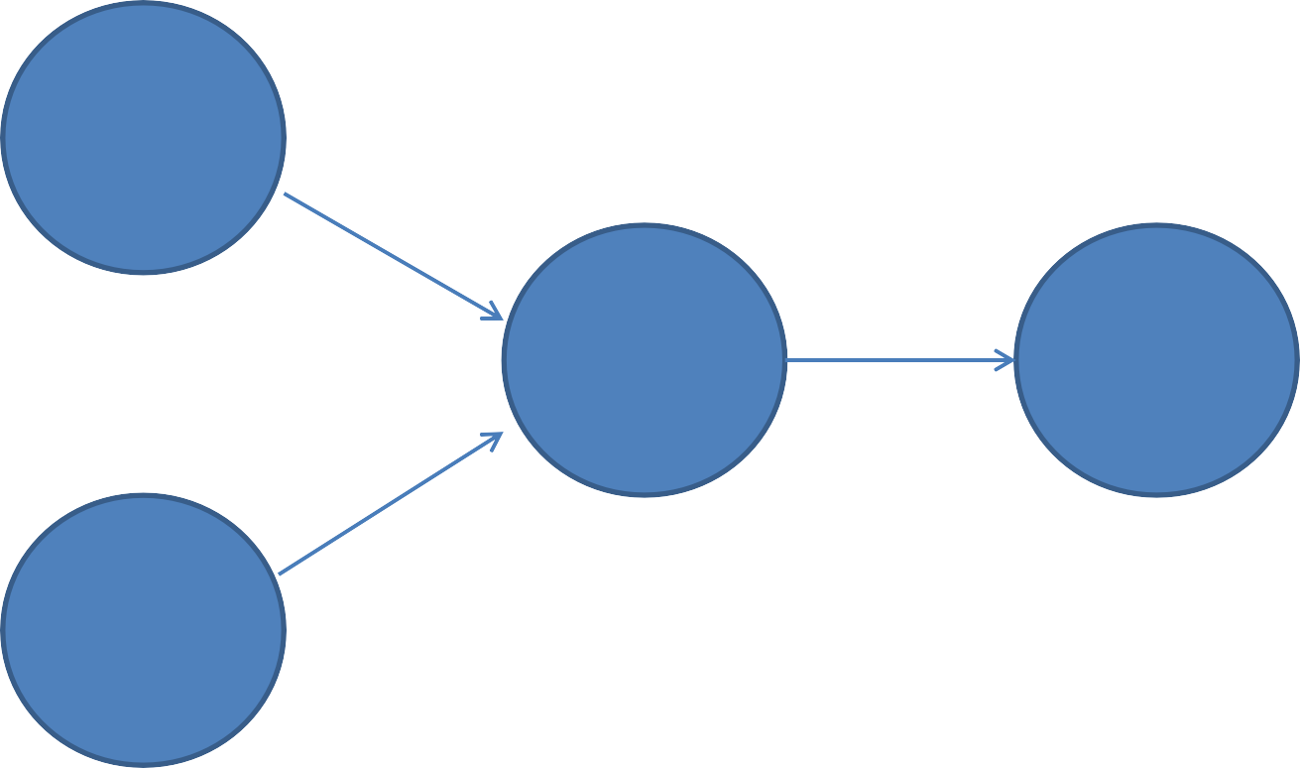
Symbolic Representation as Graph
Tensors are inputs to tensor operations, which output new tensors.
User constructs a symbolic representation (graph) of how tensors flow through the network.
Variable (tensor)
Op
Output (tensor)
Variable (tensor)

Slide 8
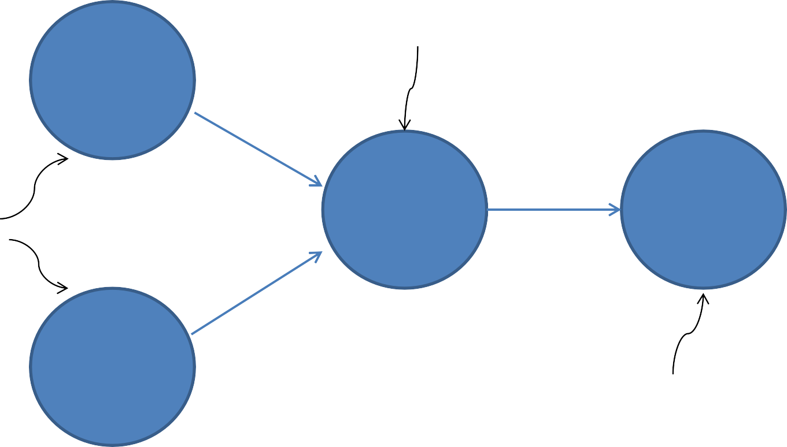
A Simple TensorFlow Graph
The two matrices are dot multiplied.
Variable (matrix)
Two matrices are defined as input.
Output
(matrix)
MatMul
Variable
(matrix)
The output is the dot product of the two matrices.

Slide 9
TensorFlow with Python - Constants
Design the Graph
import tensorflow as tf # import the Tensorflow library x1 = tf.constant( 1.0 ) # define some constants
x2 = tf.constant( 2.0 )
By default, values are
floating point numbers
Run the Graph
sess = tf.session()
# connect session for execution
sess.run( [x1, x2] )
# run the graph
[ 1.0, 2.0 ]

Slide 10
TensorFlow with Python - Operations
Design the Graph
import tensorflow as tf # import the tensorflow library
x1 = tf.constant( 1.0 ) x2 = tf.constant( 2.0 ) x3 = tf.add( x1, x2 )
# define some constants
# add inputs x1 and x2
Run the Graph
sess = tf.session()
# connect session for execution
sess.run( x3 )
# run the graph
When node x3 is executed, it takes the inputs x1 and x2
3.0
and applies the tensor add operation. Since these are scalar
values, they are added together to output a new scalar value.

Slide 11
TensorFlow with Python - Placeholders
Design the Graph
import tensorflow as tf # import the Tensorflow library
x1 = tf.placeholder( tf.float ) x2 = tf.placeholder( tf.float ) x3 = tf.add( x1, x2 )
Run the Graph
# define some placeholders
# add inputs x1 and x2
The data is bound at run time (parameterized variables).
sess = tf.session()
# connect session for execution
sess.run( x3, {x1: 1.0, x2: 2.0} )
# run the graph
When node x3 is executed, it binds the values to the inputs x1 and x2
3.0
and applies the tensor add operation. Since these are scalar
values, they are added together to output a new scalar value.

Slide 12
TensorFlow with Python - Binding
Design the Graph
import tensorflow as tf # import the Tensorflow library
x1 = tf.placeholder( tf.float, shape=[2] ) x2 = tf.placeholder( tf.float, shape=[2] ) x3 = tf.add( x1, x2 )
Run the Graph
# define some placeholders
# add inputs x1 and x2
Bound an array instead of a scalar value
sess = tf.session() # connect session for execution
sess.run( x3, {x1: [1.0,2.0], x2: [3.0,4.0]} ) # run the graph
Matrix addition
[ 4.0, 6.0 ]

Slide 13
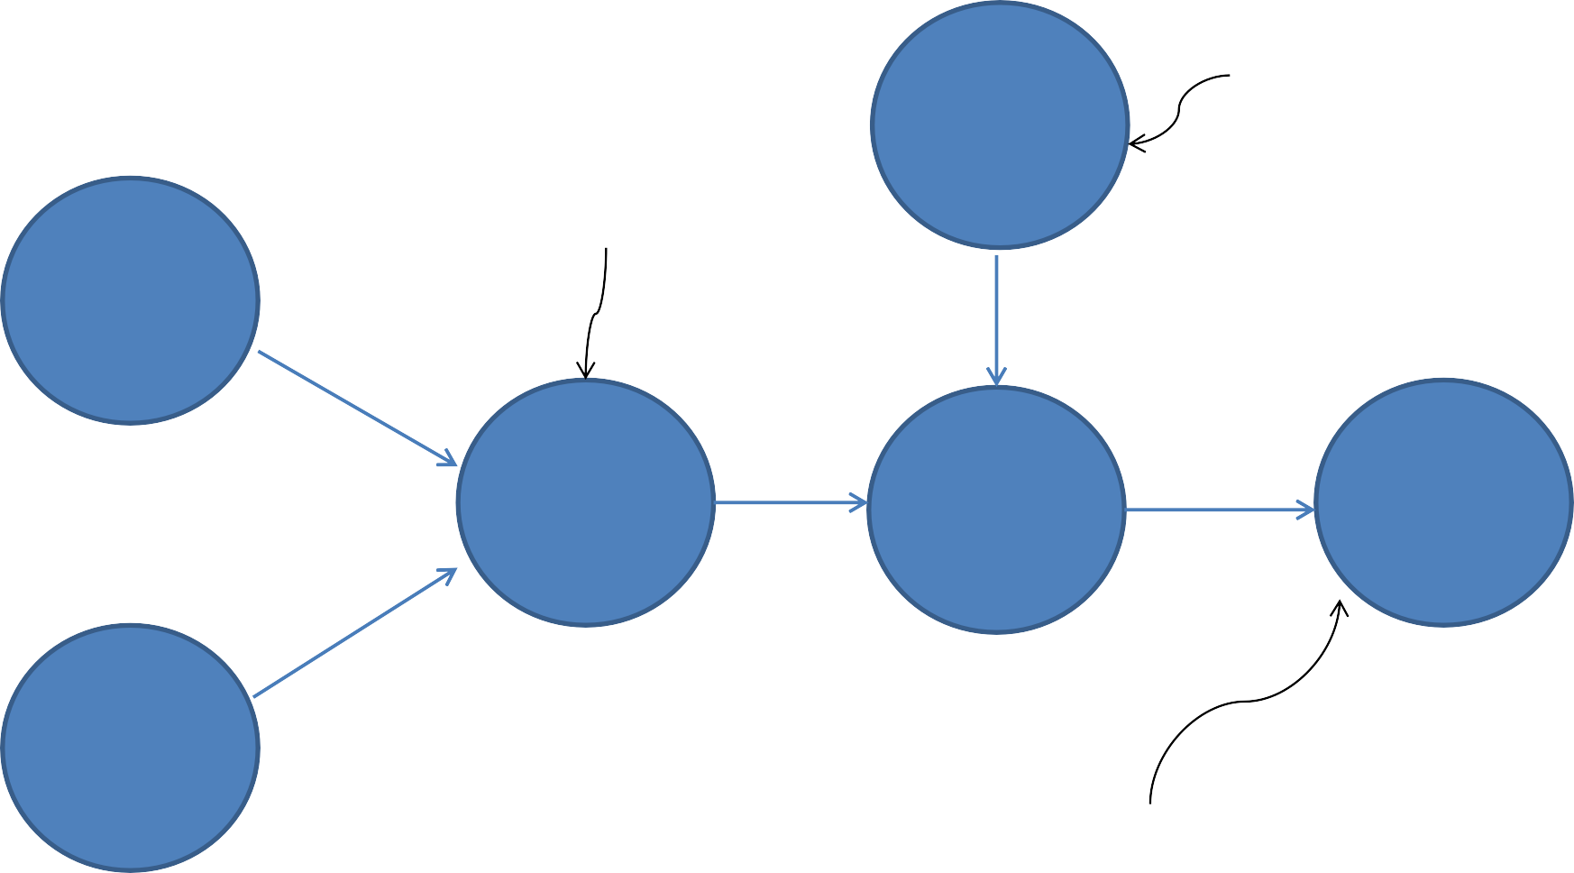
Multiple Operation TensorFlow Graph
Weight applied to operation.
Constant (Scalar)
The two matrices are added.
Variable
(matrix)
MatAdd
Output (matrix)
MatMul
Variable (matrix)
The output is the dot
product (weight) of the addition of the two matrices.

Slide 14
TensorFlow with Python – Multi-Op
Design the Graph
import tensorflow as tf # import the Tensorflow library
x1 = tf.placeholder( tf.float ) x2 = tf.placeholder( tf.float ) x3 = tf.add( x1, x2 )
x4 = tf.muliply( x3, 3.0 )
Run the Graph
# define some placeholders
# add inputs x1 and x2
# multiply the result by 3
sess = tf.session() # connect session for execution
sess.run( x4, {x1: [1.0,2.0], x2: [3.0,4.0]} ) # run the graph
Matrix multiply (weight) applied to Matrix addition
[ 12.0, 18.0 ]

Slide 15
TensorFlow with Python – Operators
Design the Graph
import tensorflow as tf # import the Tensorflow library
x1 = tf.placeholder( tf.float, shape=[2] ) x2 = tf.placeholder( tf.float, shape=[2] ) x3 = x1 + x2
x4 = x3 * 3.0
# define some variables
# add inputs x1 and x2
# multiply the result by 3
Shortcut (or inline) operator
Run the Graph
sess = tf.session() # connect session for execution
sess.run( x4, {x1: [1.0,2.0], x2: [3.0,4.0]} ) # run the graph
[ 12.0, 18.0 ]

Slide 16
TensorFlow with Python – Variables
Design the Graph
import tensorflow as tf # import the Tensorflow library
a = tf.Variable( tf.float ) # define some variables b = tf.Variable( tf.float )
x = tf.placeholder( tf.float, shape=[4] )
yhat = a + b * x # simple linear regression
Variables must be explicitly initialized prior to running the graph
Run the Graph
sess = tf.session()
# connect session for execution # initialize global variables
init = tf_global_variables_initializer() sess.run(init)
sess.run( yhat, {x: [1,2,3,4]} )
# run the graph
[ 0, 0.30000001, 0.60000001, 0.90000001 ]
Run simple linear regression for x = 1, 2, 3 and 4
Example from tensorflow.org

Slide 17
TensorFlow with Python – Loss Function
Design the Graph
y = tf.placeholder( tf.float ) squares = tf.square( yhat – y ) loss = tf.reduce_sum( squares )
# labels (actual values) # square of error
# summation of squared errors
Sum up the squared difference of the actual and predicted values.
Run the Graph
sess = tf.session()
init = tf_global_variables_initializer() sess.run(init)
# connect session for execution # initialize global variables
sess.run( loss, {x: [1,2,3,4], y:[0,-1,-2,-3]} ) # execute the graph
Run simple linear regression for x = 1, 2, 3 and 4
with actual values 0, -1, -2 and -3.
23.66
Example from tensorflow.org

Slide 18
TensorFlow with Python – tf.train
Design the Graph
optimizer = tf.train.GradientDescentOptimizer( 0.1 ) train = optimizer.minimize( loss )
# training model
Learning rate
Run the Graph
sess.run(init)
for i in range(0,1000): # train over 1000 iterations sess.run( train, {x: [1,2,3,4], y:[0,-1,-2,-3]} ) # train the model
sess.run([ b,w ] )
Train the simple linear regression over 1000 iterations to minimize the loss function.
[0.99999082, -0.9999969]
Example from tensorflow.org

